Slide 1
Smart Robot Control Information Technology
MINISTRY OF EDUCATION AND SCIENCE OF UKRAINE
SUMY STATE UNIVERSITY
DEPARTMENT OF COMPUTER SCIENCE
Head of Department Dovbysh A.S.
Student Group ІN.m-05AH Uba B.V.
Supervisor Oleksiienko G.A.
2021

Slide 2
WHY MAPPING Smart ROBOTS ARE NEEDED
Consider a home robot vacuum, Without SLAM, it will just move randomly within a room and may not be able to clean the entire floor surface.
Robots with SLAM can use information such as the number of wheel revolutions and data from cameras and other imaging sensors to determine the amount of movement needed.
SLAM robots can also be used for parking a self-driving car in an empty spot, or delivering a package by navigating a drone in an unknown environment.
SLAM - simultaneous localization and mapping

Slide 3
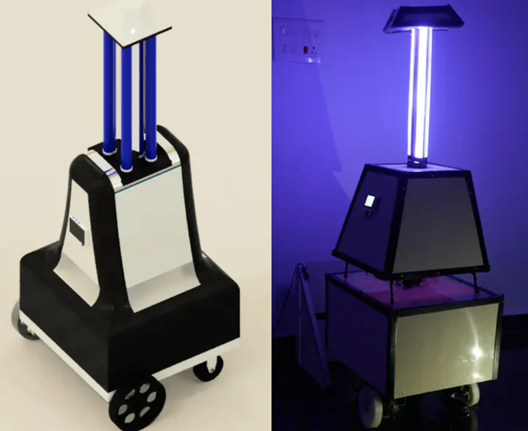
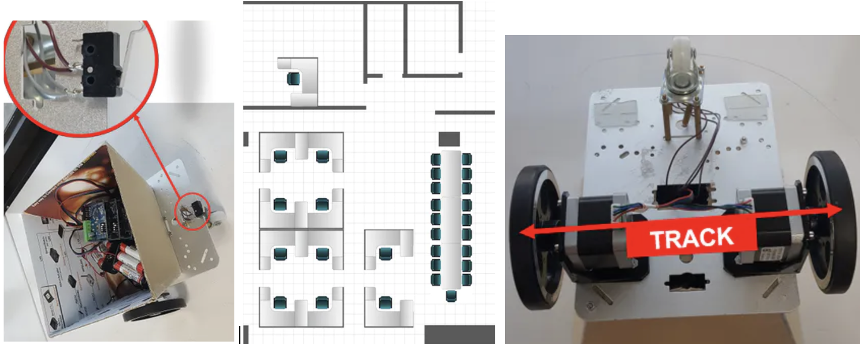
INFORMATION REVIEW
Autonomous UV Robot with SLAM
WIFI CONTROLLED SMART CAR
Figure 2. Design of a simple smart car which is controlled through the Wi-Fi
Figure 1. Design of the UV smart car.

Slide 4
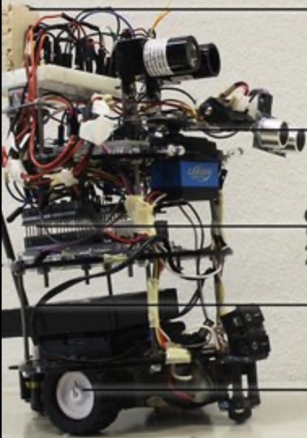
Human Navigation SMART CAR
Figure 3. Human navigation bot using indoor mapping

Slide 5
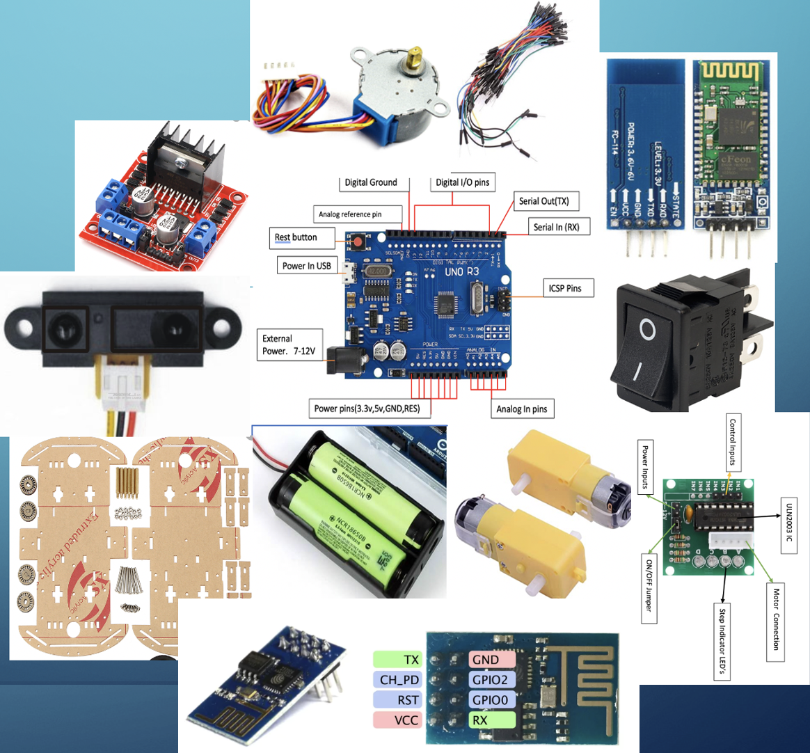
COMPONENTS USED
SELECTING OF PROGRAMMING INSTRUMENTS
L298N Motor Driver IC
IR distance Sensor
ULN2003 stepper motor driver
Stepper Motor
Arduino Mega2560
Power Supply
On/Off switch
DC Motors
Motor wheels
Jumper wires
HC-06 Bluetooth model
4WD smart car chassis

Slide 6
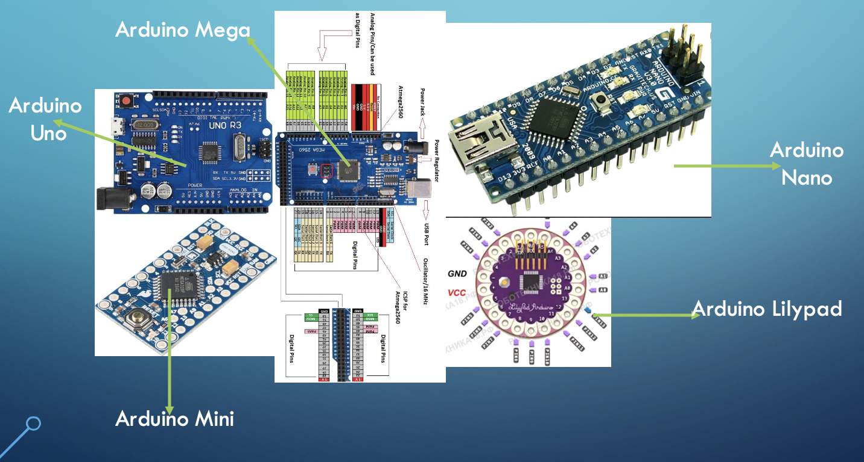
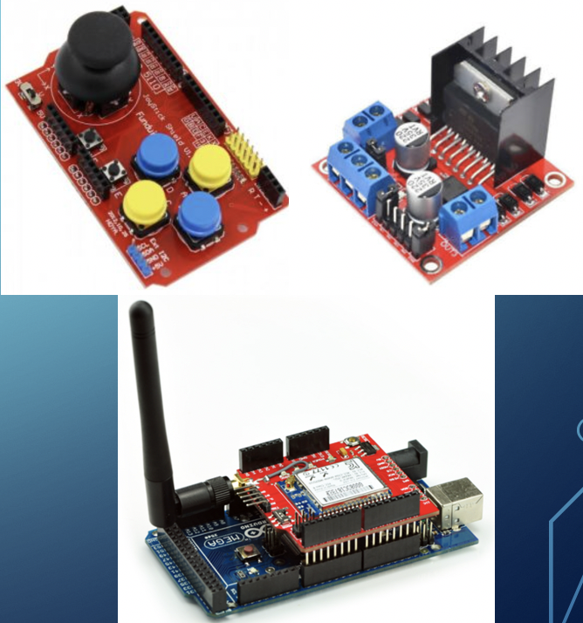
Arduino Boards:
Arduino Shields
Figure 4. Different Arduino boards
Figure 5. Arduino shields
:

Slide 7
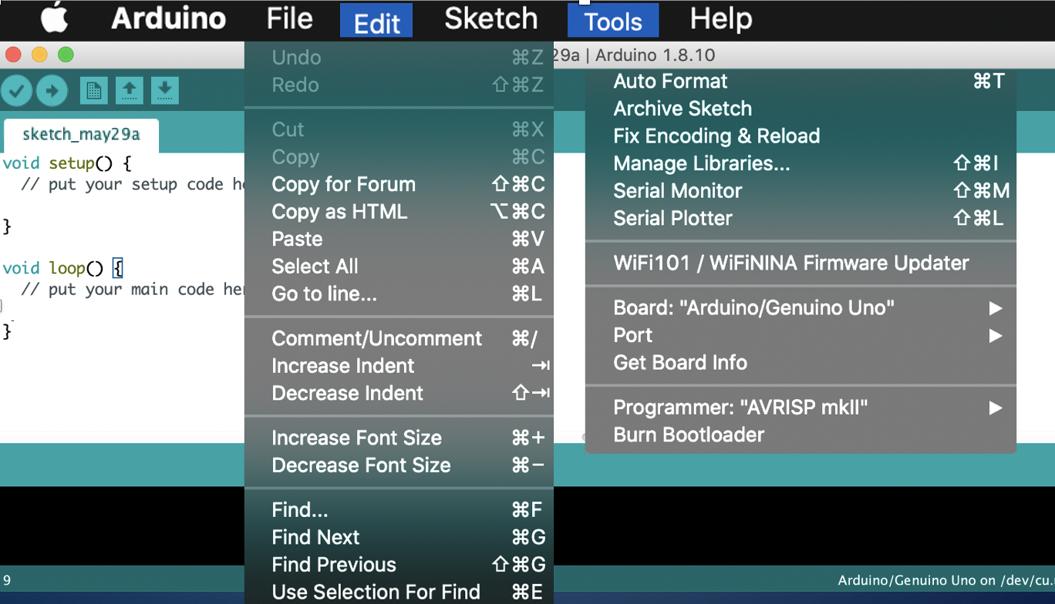

Arduino IDE
PYGAME
Figure 7. Pygame – Library For Game development
Figure 6. Arduino IDE

Slide 8
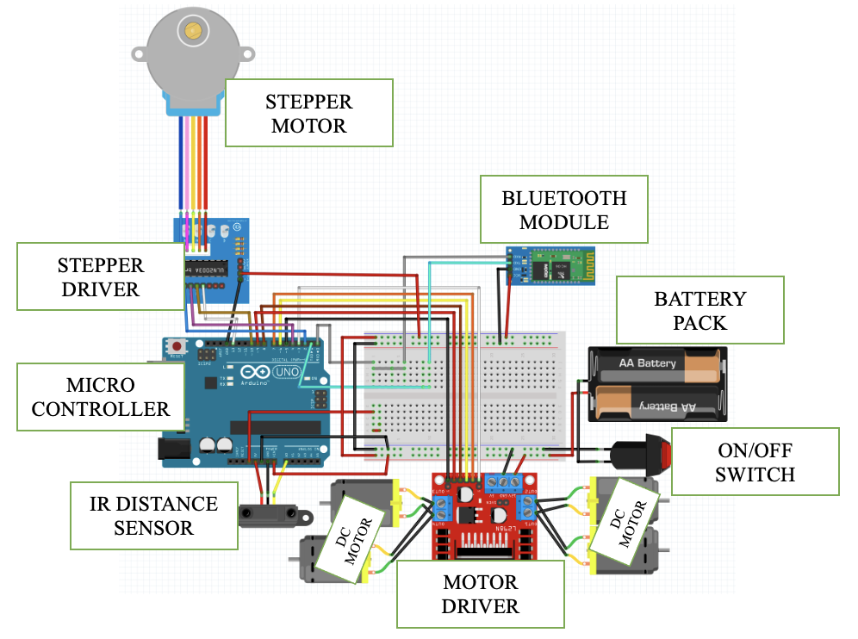
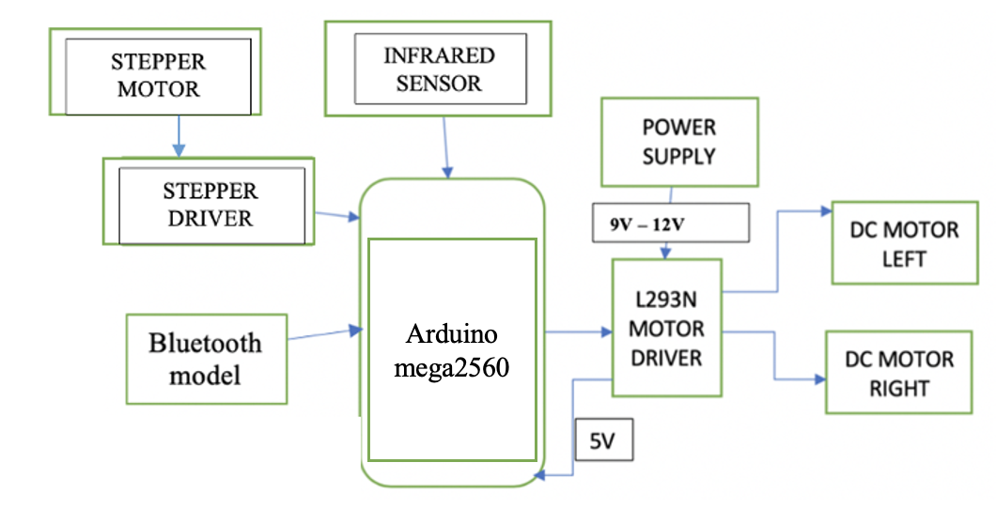
APPLICATION REALIZATION
STRUCTURE DIAGRAMS
Figure 8. Structure Diagram
Fig. 9 - ROBOT SCHEME

Slide 9
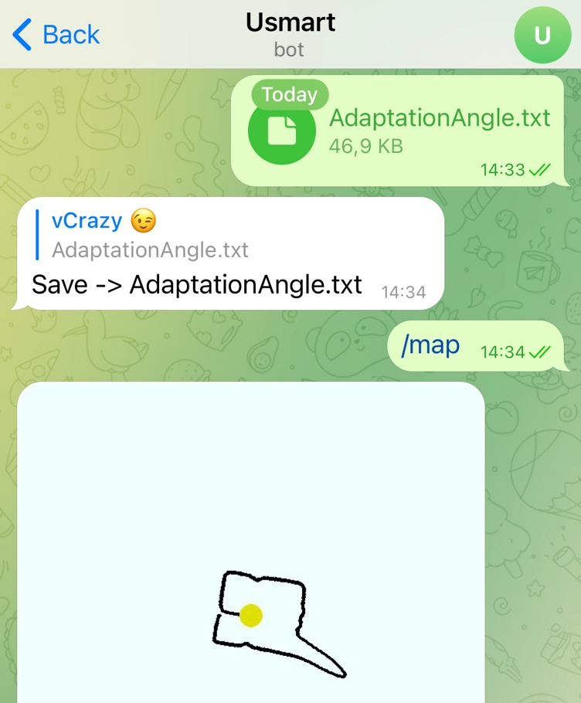
Telegram-bot
Creating New Chat Bot
BotFather ➠ use the “/newbot” ➠ input name and username.
*The bot will give user a unique token entering details.
Using “@Mappingcarbot” Chat Bot
- Send txt File ➠ Save File ➠ “Use “/map” command.
TelegramBot Chat for Smart Car
NOTE: username must finish with 'bot,' e.g.'smartcar bot' or 'SmartCarBot.’

Slide 10
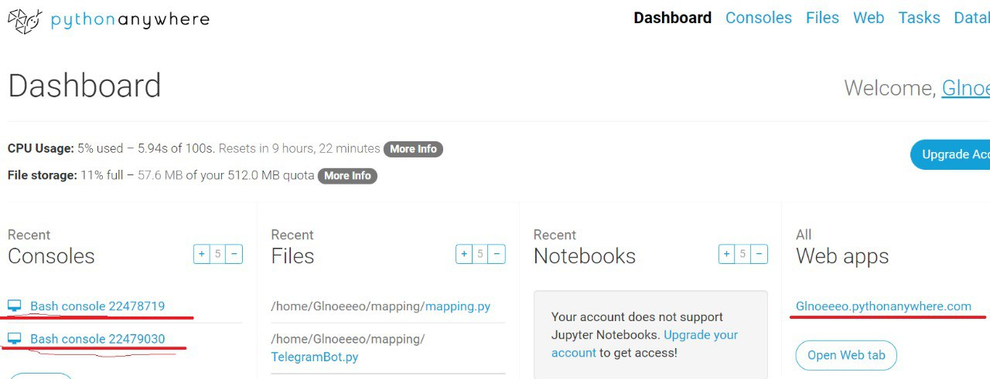
Server implementation
An online platform called the “Pythonanywahere.com”, It allows you to access server-based Python and Bash command-line interface from within your browser.
Two Bash console: telegramBot.py @ mapping.py

Slide 11
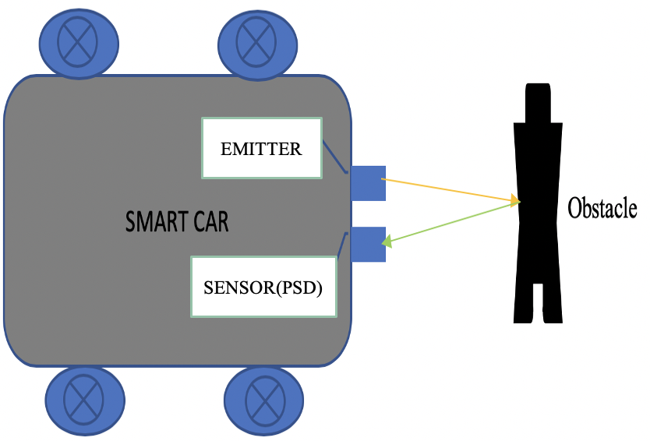
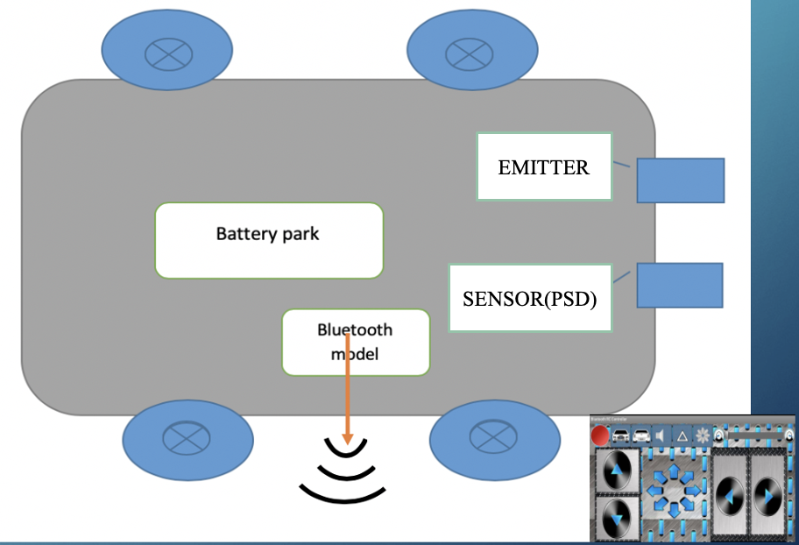
WORKING PRINCIPLE
Figure 10. IR DISTANCE SENSOR.
Figure 11. Bluetooth control.
NOTE: PSD – Position sensing device

Slide 12
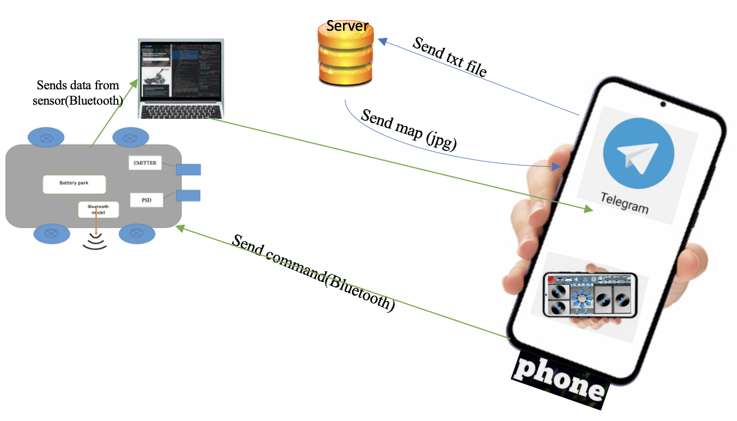
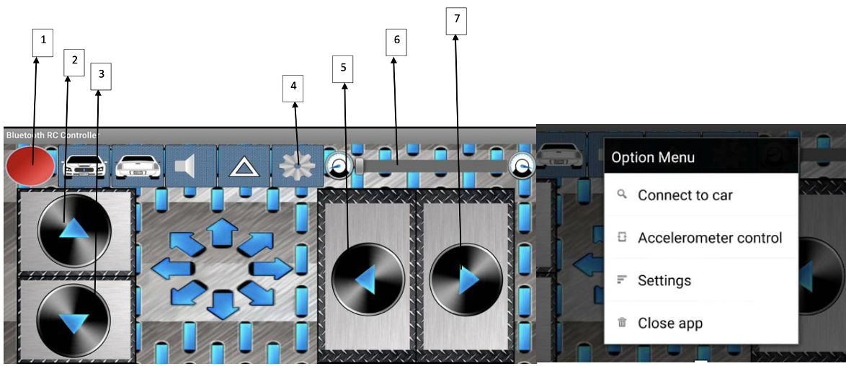
WORK PRINCIPLE
Figure 12. Smart Car control Scheme.
Figure 13. Bluetooth RC controller.

Slide 13
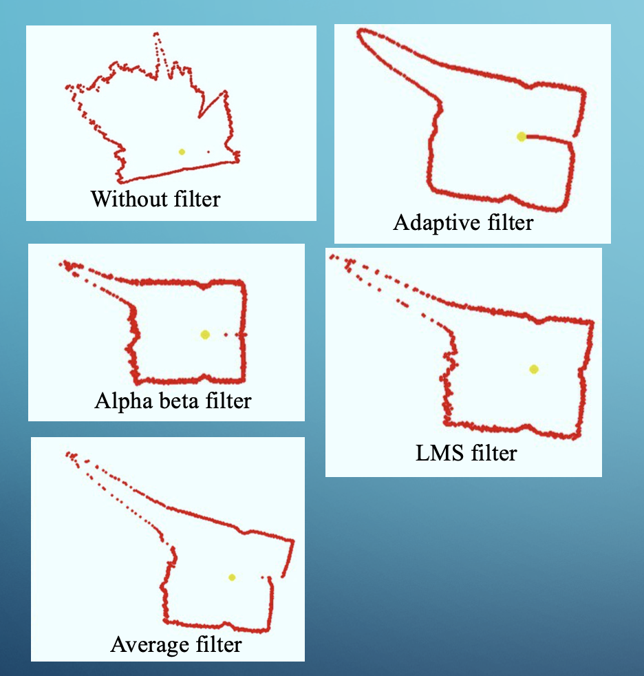
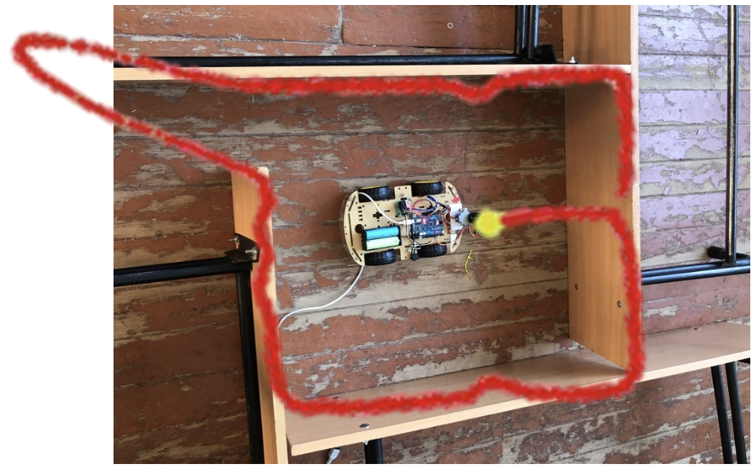
Choice Filter
Figure 15 - Overlapping Adaptive filter
“Adaptive Filter” choice of filter for my project is placed over on the actual environment used for the project test purposes.
Figure 14 - Test filter maps

Slide 14
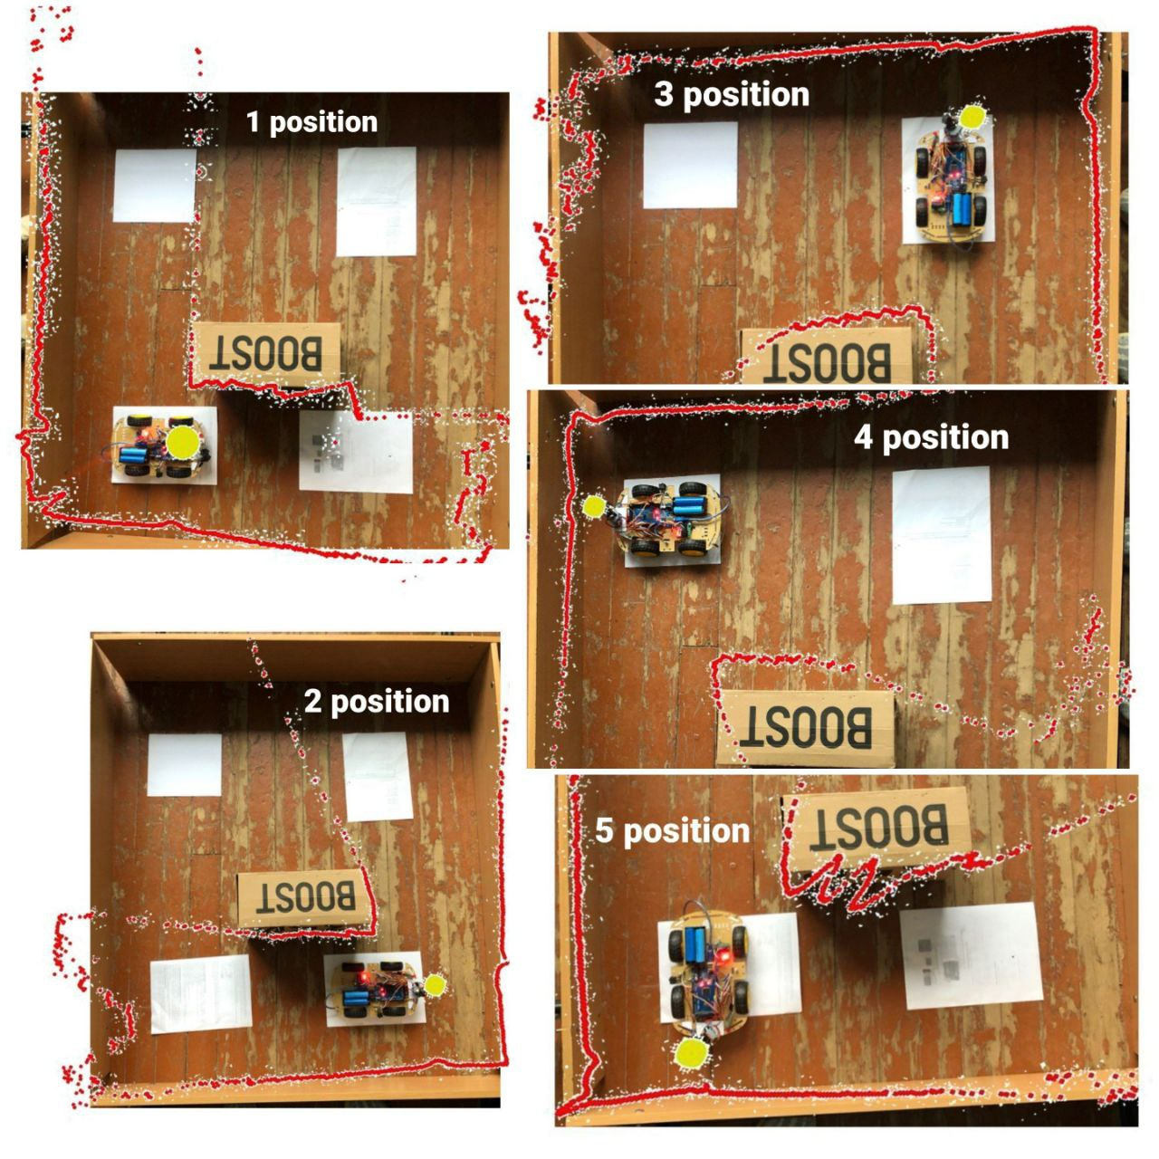
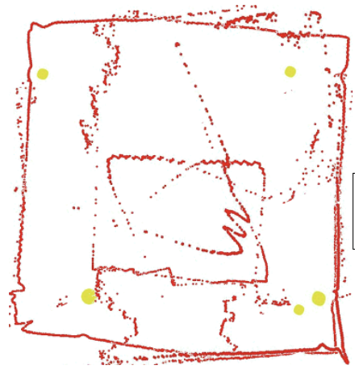
BUILDING AN AREA MAP
Fig 17 - Combining all position map
Fig. 16 - Overlapping all position map with real image

Slide 15
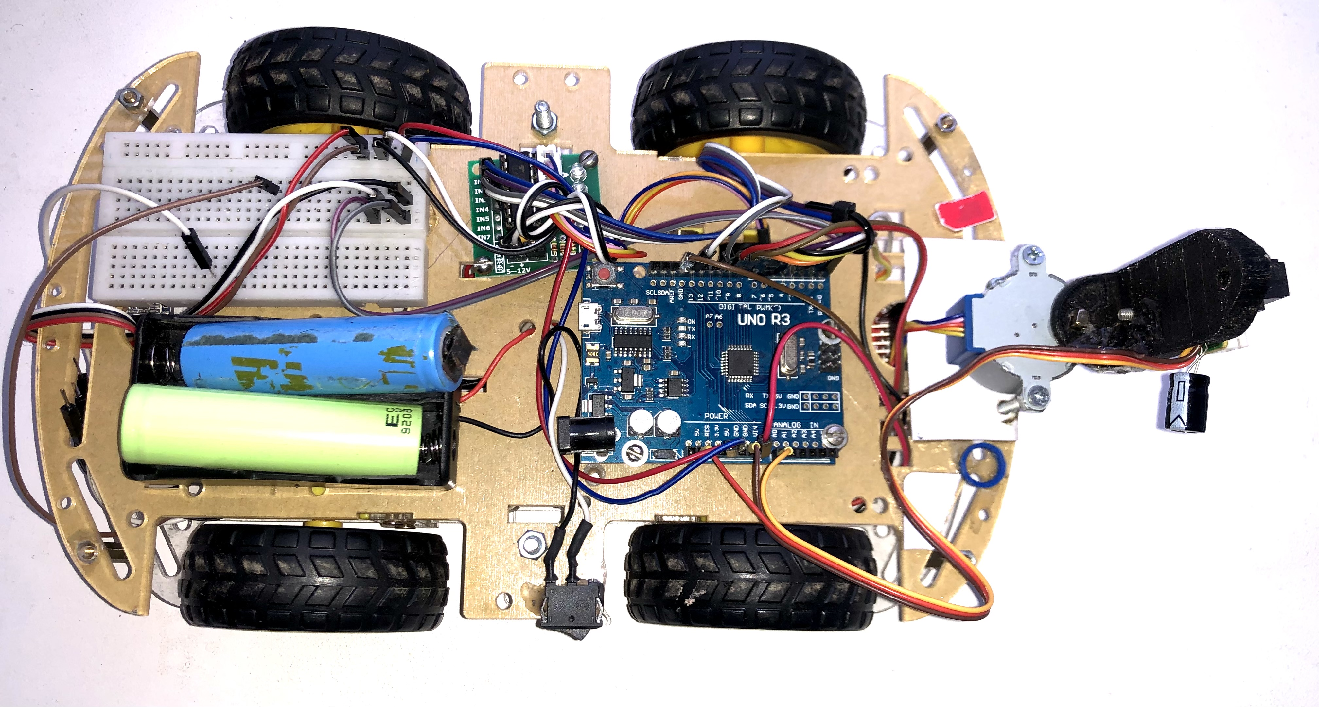
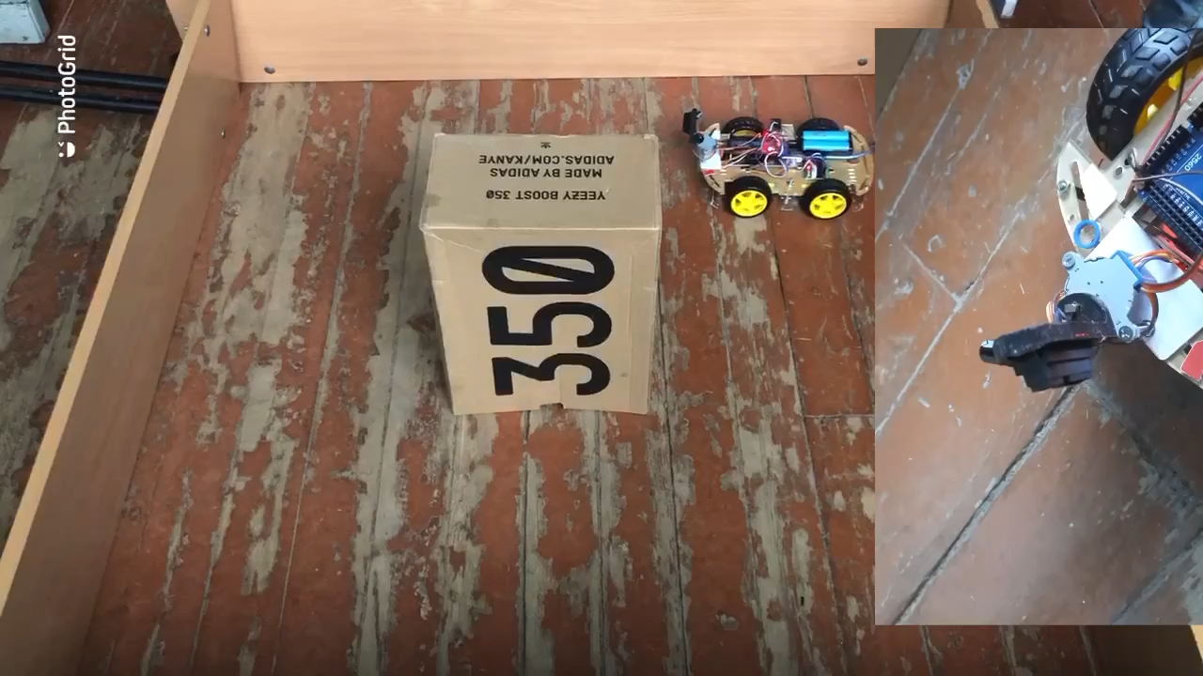
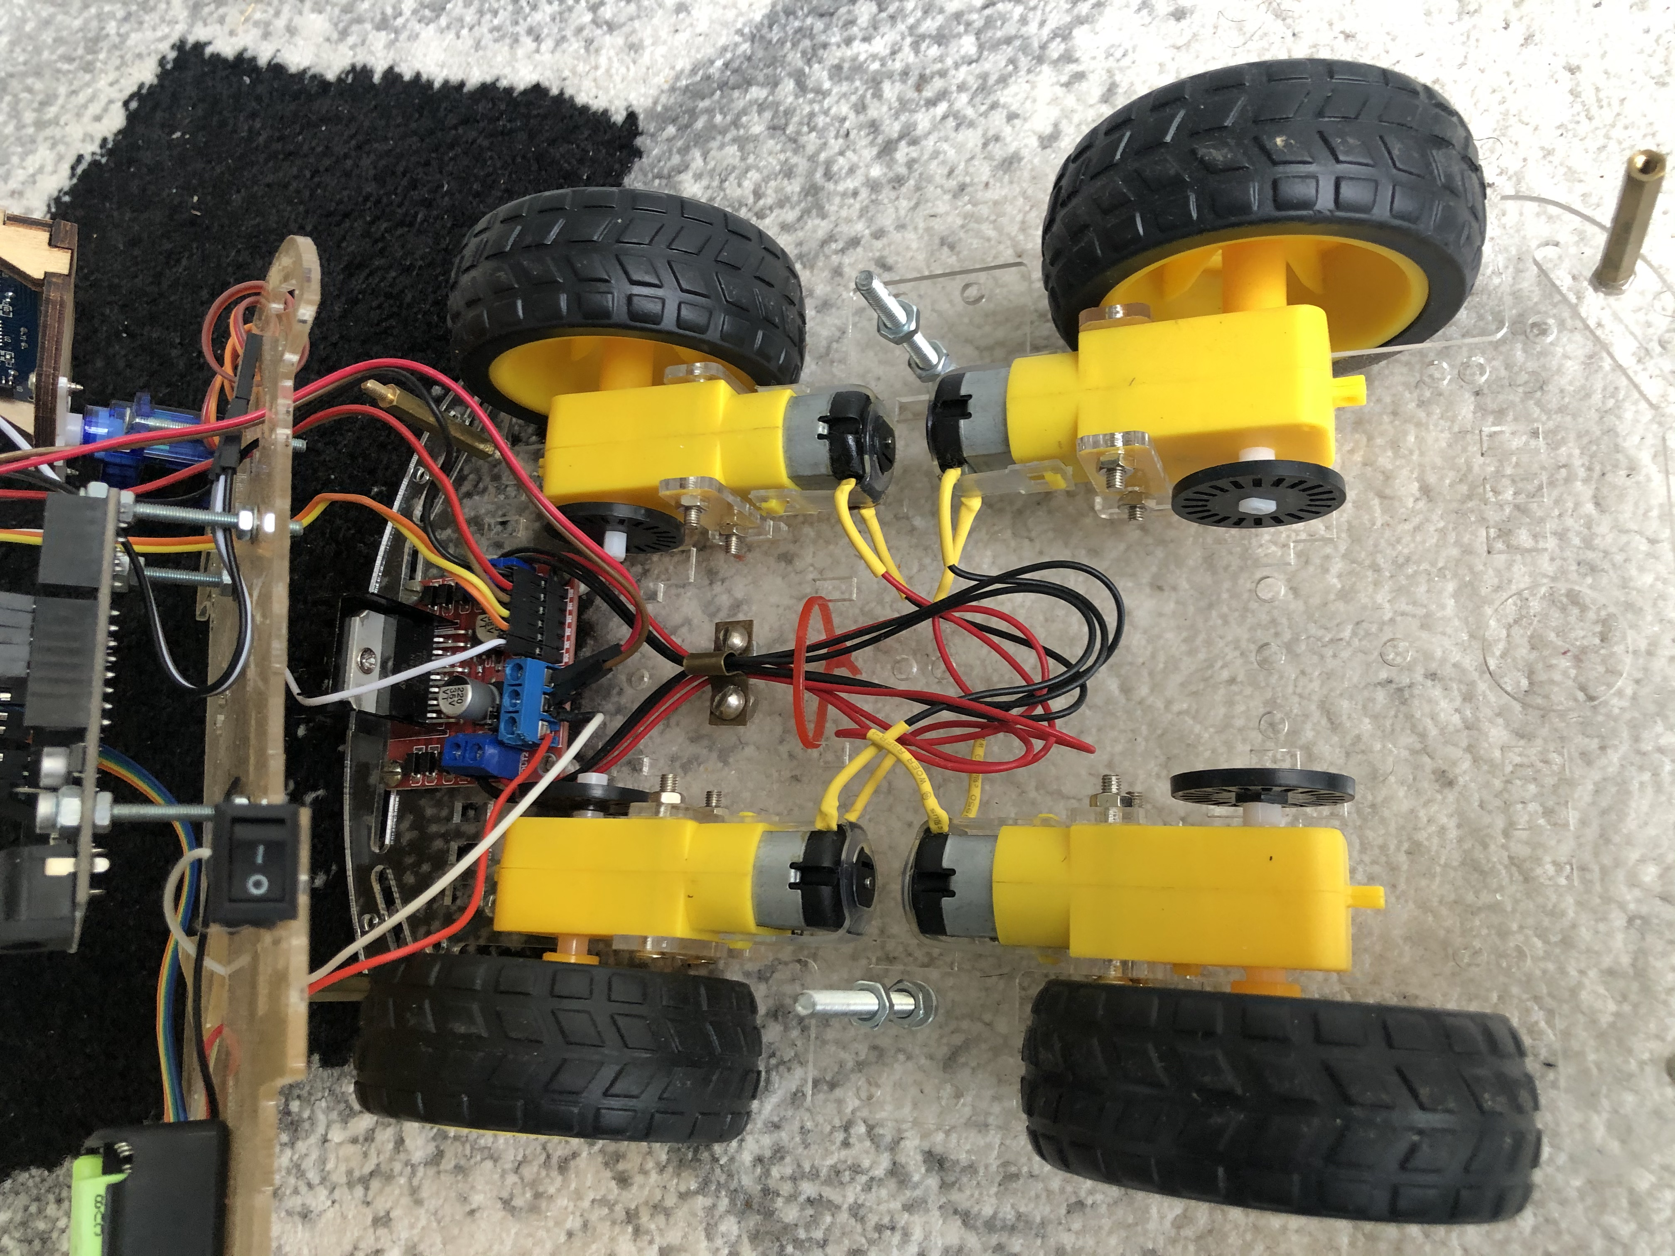
Robot design

Slide 16
CONCLUSION
After analyzing the methods and tools, I designed a prototype of a mapping system and a system for transferring data between the elements of the system.
To send data to the server and display a map of the area, a telegram bot was developed and launched on the server. A Pygame to build the map was used
As a result, all the tasks were achieved. A prototype of a mapping system has been developed, which creates a map of the area with good accuracy. In the future, it is possible to make improvements to the system when deciding an algorithm for simultaneous localization and mapping (SLAM), to that already for detailing objects in 3-D space.

Slide 17
THANK YOU FOR YOU ATTENTION
THE END

